Slide 1
FROM WASTE TO VALUE: APPLYING THE TRIPLE BOTTOM LINE THEORY TO WASTE MANAGEMENT IN NIGERIA’S AGRO ALLIED INDUSTRIES.
PRESENTED AT THE RESEARCHERS MONTHLY SEMINAR SERIES OF THE NATIONAL CENTER FOR TECHNOLOGY MANAGEMENT
By
Kazeem Abubakar (PhD), Blessing Enyojo, Emmanuel Iroh, Ugwu Ukamaka, Valentina Asim Thompson-Adewale.
March 25th 2026

Slide 2
outline
Background of the study
Problem statement, Aim and Objectives.
Literature review
Methodology
Results
Conclusions / Recommendation

Slide 3
Background
Nigeria’s agro‑allied industries contribute significantly to GDP, employment and food security.
However, large volumes of organic waste are generated from processing activities.
Poor waste management has led to environmental degradation, economic loss and negative social impacts.

Slide 4
Research Problem
Inefficient solid waste management in agro‑processing industries.
Limited waste‑to‑value initiatives to enable waste contribute to GDP.
Missed opportunities for circular economy and sustainable industrial development.

Slide 5
Research Aim and Objectives
Aim: Identify sustainable waste‑to‑value pathways using the Triple Bottom Line framework.
Objectives:
Examine sustainable waste‑to‑value opportunities.
Evaluate economic value lost due to waste inefficiencies.
Assess implications for economic, environmental and social sustainability.

Slide 6
Hypothesis
H₁: There’s a significant positive relationship between the percentage loss of food waste generated in the Nigera’s agro-allied processing industries and its effect / contribution to the annual GDP of Nigeria.
H₀: There’s no significant positive relationship between the percentage loss of food waste generated in the Nigera’s agro-allied processing industries and its effect / contribution to the annual GDP of Nigeria.

Slide 7
LITERATURE REVIEW

Slide 8
Literature Review
Triple Bottom Line Theory (TBL):
• People – Social sustainability
• Planet – Environmental sustainability
• Profit – Economic sustainability
The framework evaluates industrial performance beyond financial returns.
Community attitudes and behaviours at large are key obstacles to circular economy transitions, while personal responsibility and community environmental consciousness play important roles in sustainable waste management. (Voukkali et al., 2023).

Slide 9
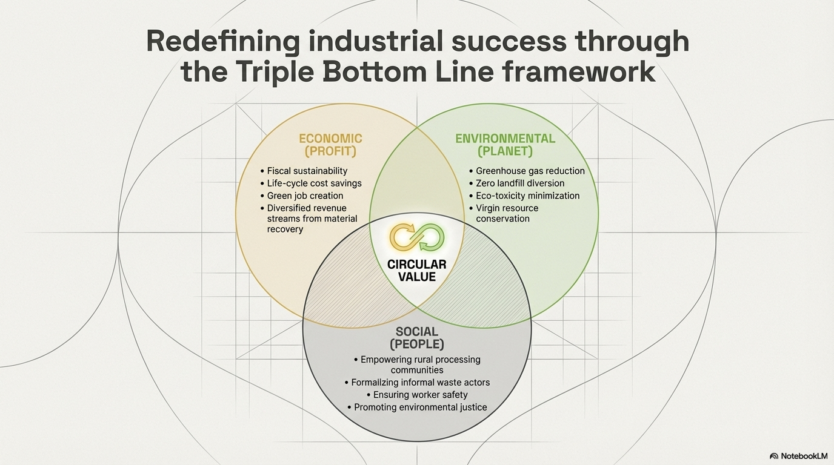
(Omokaro et al., 2025).

Slide 10
Waste‑to‑Value Concept
Waste‑to‑value converts industrial waste into useful products.
Key principle of the circular economy: reduce, reuse, recycle resources.
Benefits include resource efficiency through generation of raw materials, reduced pollution by reducing waste and new revenue streams by conversion of waste to valuable products.

Slide 11
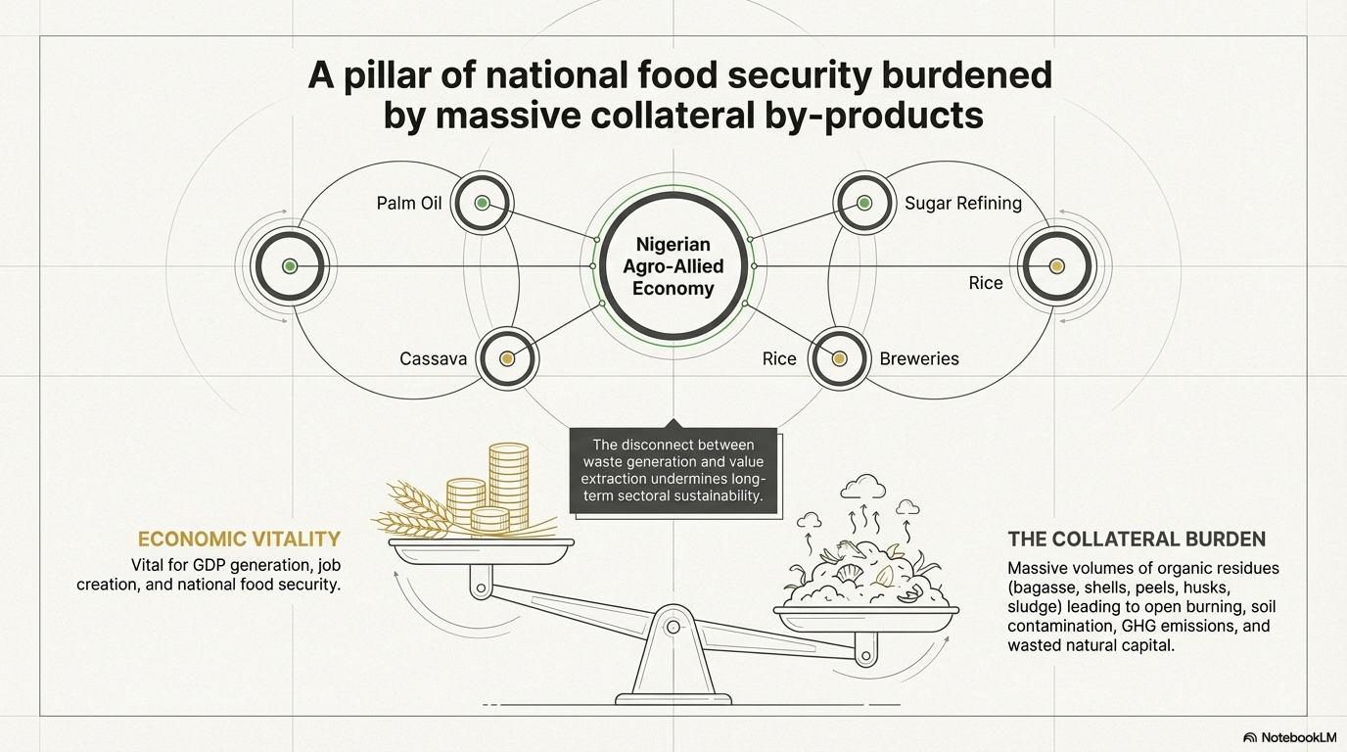
Akinniyi J.N (2023)

Slide 12
Waste Valorisation Strategies
  Biological: Involves composting, anaerobic digestion, and fermentation using organic materials that can decompose readily
Biochemical: The extraction of bioactive compounds through biochemical processes and use of biological agents.
Thermochemical: Use of high temperature through pyrolysis and gasification to breakdown waste into simpler compounds.

Slide 13
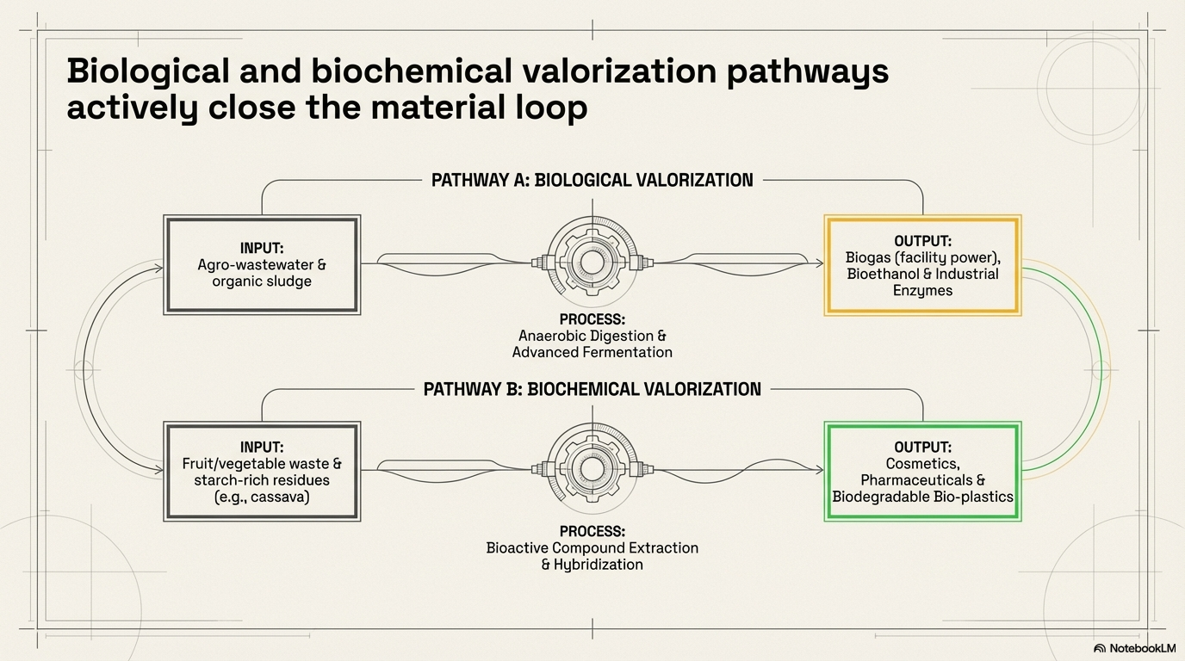
Valorization strategy
Godspower O.O et al, (2025)

Slide 14
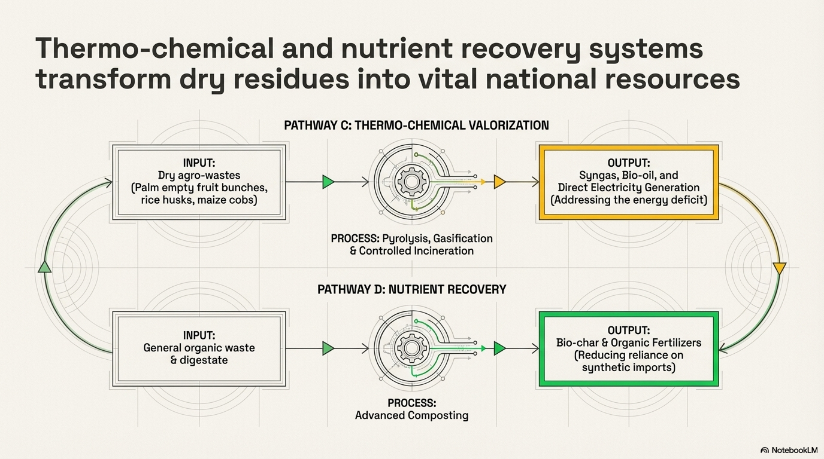
Valorization strategy

Slide 15
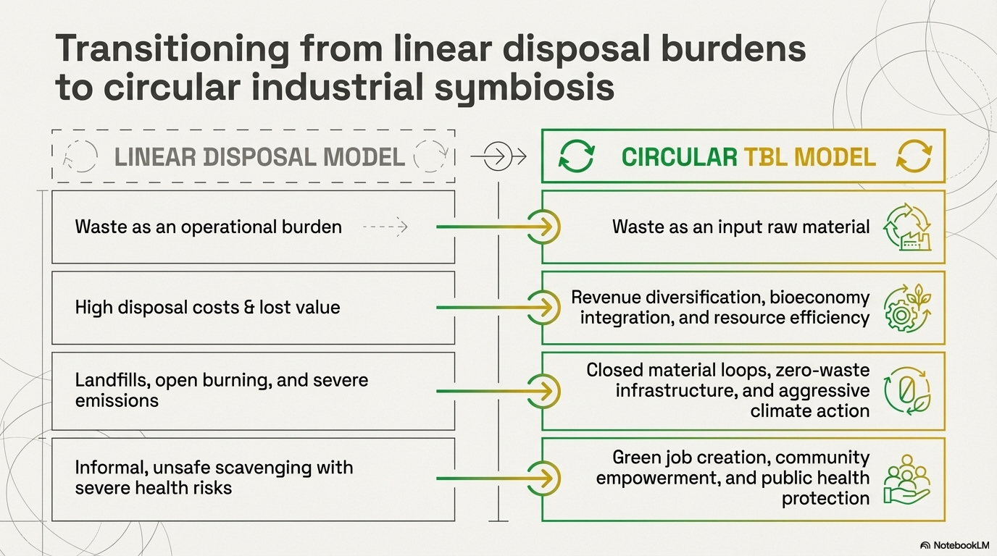
Godfrey Okeke (2014)

Slide 16
RESEARCH METHODOLOGY

Slide 17
Research Methodology
Research Design: Quantitative empirical analysis.
Data type : Secondary data
Data Source: Data used for the study was sourced from panel data available at the food and agricultural organisation (FOA).
Data Analysis : SPSS, regression and correlation analysis
Variables considered are:
Loss percentage
Year
Contribution to GDP
Sample size: 587 observations.

Slide 18
RESULTS AND DICSUSSION

Slide 19
Statistical Model
Regression Model:
Contribution to GDP = β0 + β1(Loss Percentage) +
β2(Year) + μ
Purpose: Determine relationship between waste losses and economic performance

Slide 20
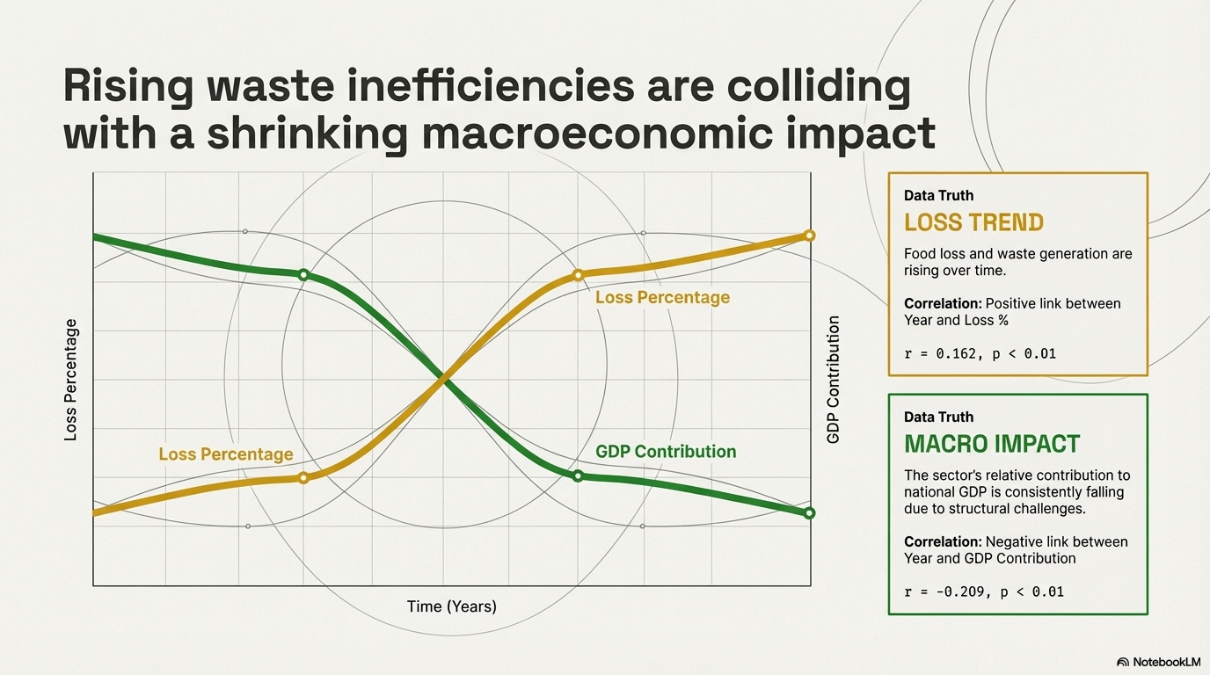
Results

Slide 21
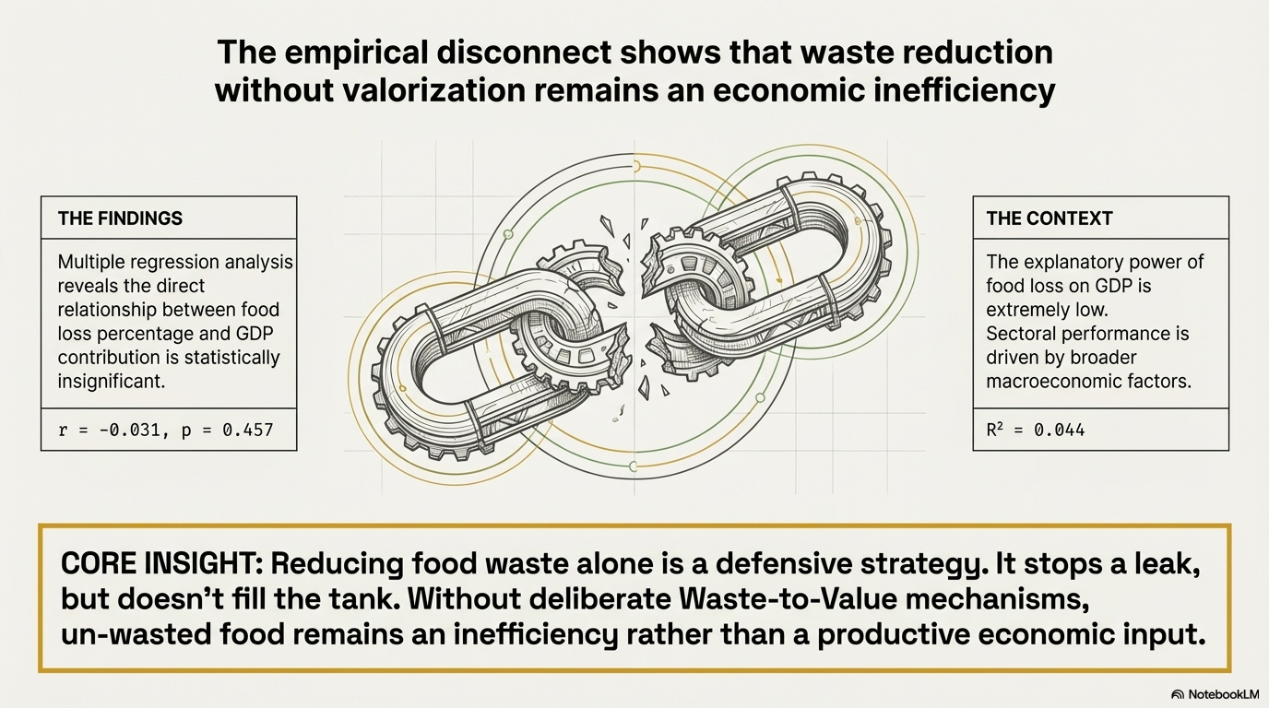
Results

Slide 22
The ANOVA results supports the regression model as it shows a positive significant (F (2, 584) = 13.368, p < 0.001). This implies that loss percentage and year together exert a significant influence on contribution to GDP.

Slide 23
Triple Bottom Line Implications
Economic: Lost revenue from unutilised waste. (Ghisellini et al., 2016; Osman et al., 2022)
Environmental: pollution and greenhouse gas emissions.
Social, not practically measured, but inferred: lost employment opportunities and food security concerns (Jurgilevich et al., 2016).

Slide 24
CONCLUSION AND RECOMMENDATIONS

Slide 25
Relative contribution of agro-allied waste to GDP is falling
Food loss percentage and contribution to GDP is statistically insignificant
Positive correlation between year and percentage loss of agro-allied waste

Slide 26
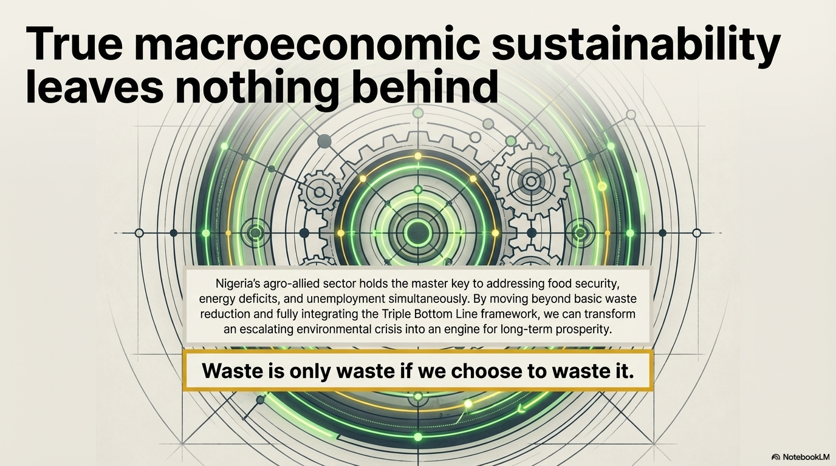
Conclusion

Slide 27
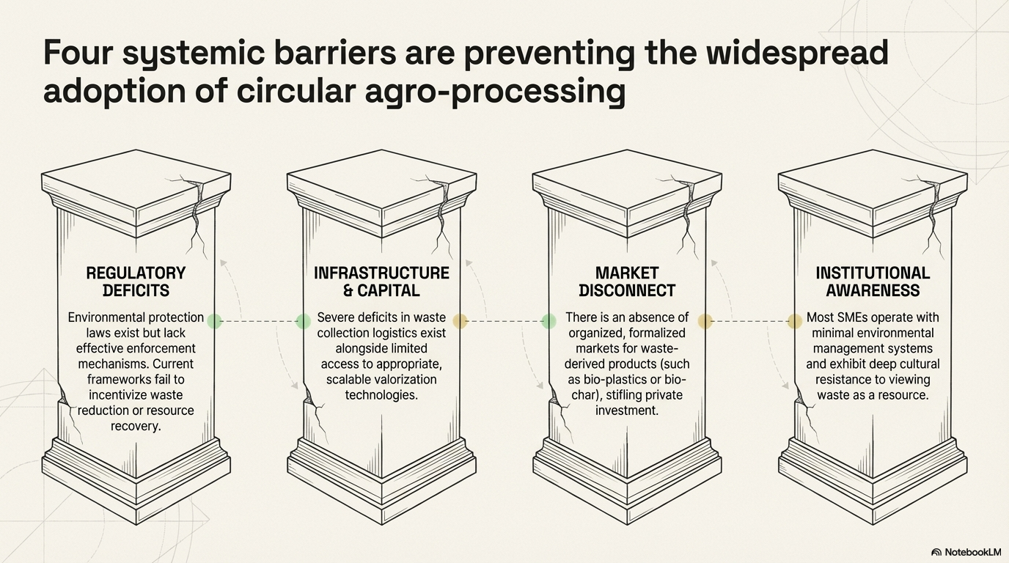
Recommendations

Slide 28
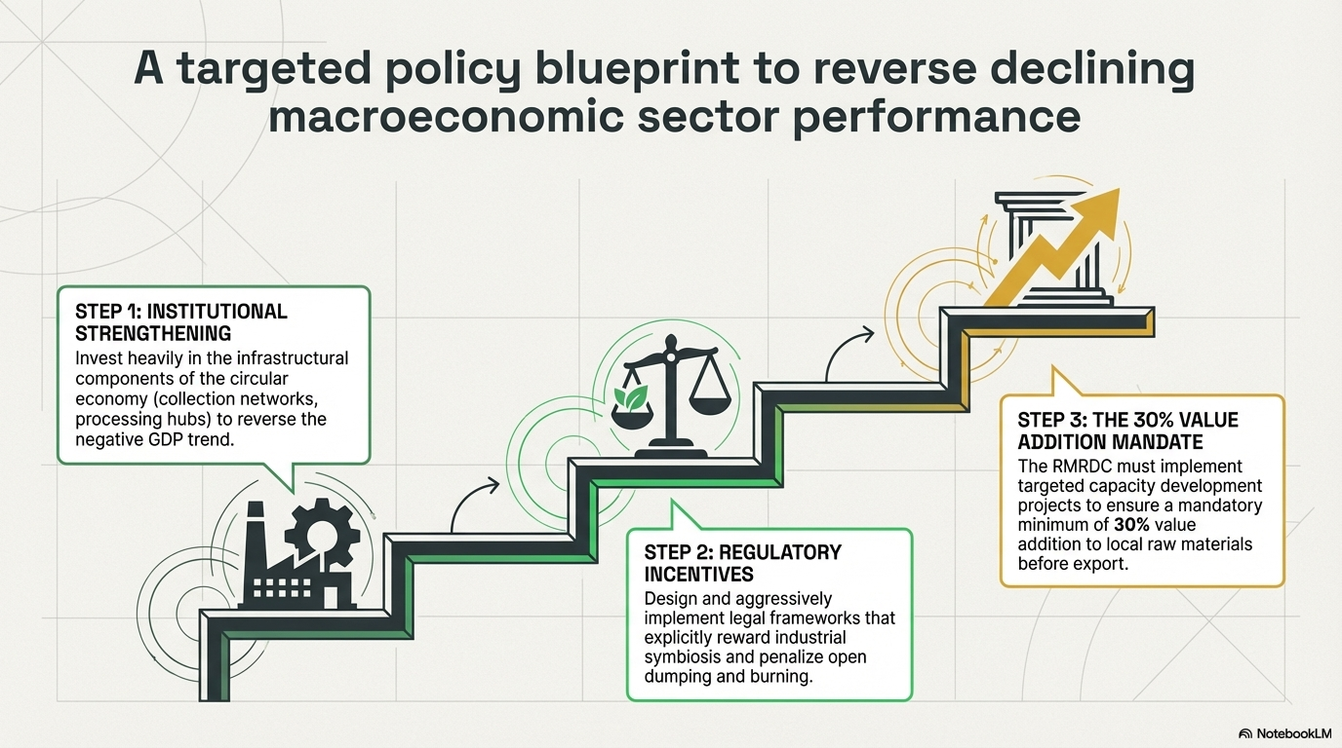
Recommendations

Slide 29
THANK YOU FOR LISTENING

